Slide 1

Project Set Up

Slide 2
Azure Portal URLs
Azure Portal: https://portal.azure.com
Azure DevOps Portal: https://dev.azure.com
Azure Trail Account Creation: https://github.com/rameshp1234567/Docs/blob/main/MicrosoftTrailAccountCreation.docx
Demo Project: https://github.com/rameshp1234567/DemoProject

Slide 3
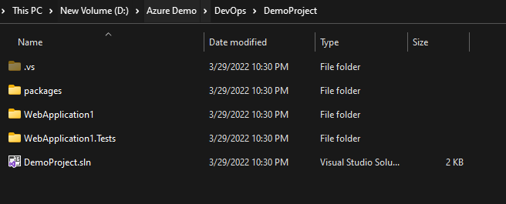
Project Set Up
Login into dev ops portal
Click on Create a Project button to create project in your organization
Default will dev ops will create an empty devops repository with the same project name. You can create your own if you want.
Now, use our demo project to push code into our empty repository with default branch as master by following instructions.
dfd
If it is new project:
a. git init --> Initiate a git into your application
b. git add . --> . Indicated all files which are adding into the git
c. git commit –m “first commit”
d. git branch –M master → It will create a master branch in your repository
e. git remote add origin <your repository URL>
f. git push –u origin master → Push your code from local to devops repository
Doesn’t have git folder

Slide 4
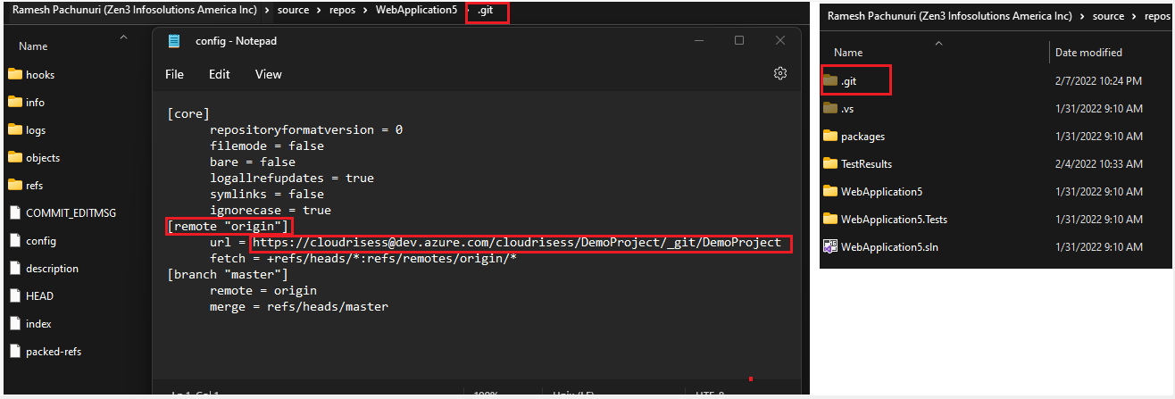
How do we know if the project has the existing repo?
If the git config file contains any repo URL which indicates that the project has already have an existing repository
If you want to push into a new repository then, you have to remove the old repository and push the code by updating with the new one with the help of git commands.

Slide 5
Push the code of existing repository into new repository
Follow the below git commands to push the existing repo code to new repo.
a. git remote rm origin → Remove the old origin from git
b. git remote add origin <your new repository URL>
c. git add . --> . Indicated all files which are adding into the git
d. git commit –m “first commit”
e. git branch –M master → It will create a master branch in your repository
f. git push -u origin –all → Push your code from local to repo

Slide 6
Thank You

